Slide 1
Data Development Utilizing Database Design and SQL
Day 8
Notes:
1

Slide 2
Using SQL in a Programming Environment
SQL is a nonprocedural language
Use simple commands to communicate tasks to computer (database)
PL/SQL is a procedural language
Must provide step-by-step process for accomplishing tasks
You can embed SQL in another language, such as PL/SQL or T-SQL (SQL Server)
Useful when needed tasks are beyond the capabilities of SQL
You cannot embed SQL commands in MS Access programs

Slide 3
Using Functions
Aggregate functions
Perform calculations based on groups of records
SUM is an example
Other SQL functions
Affect single records
Vary from one SQL implementation to another

Slide 4
Character Functions
UPPER function
Displays a value in uppercase letters
Function operates on an argument
LOWER function
Displays a value in lowercase letters
Can use functions in WHERE clauses
MS Access uses UCASE and LCASE

Slide 5
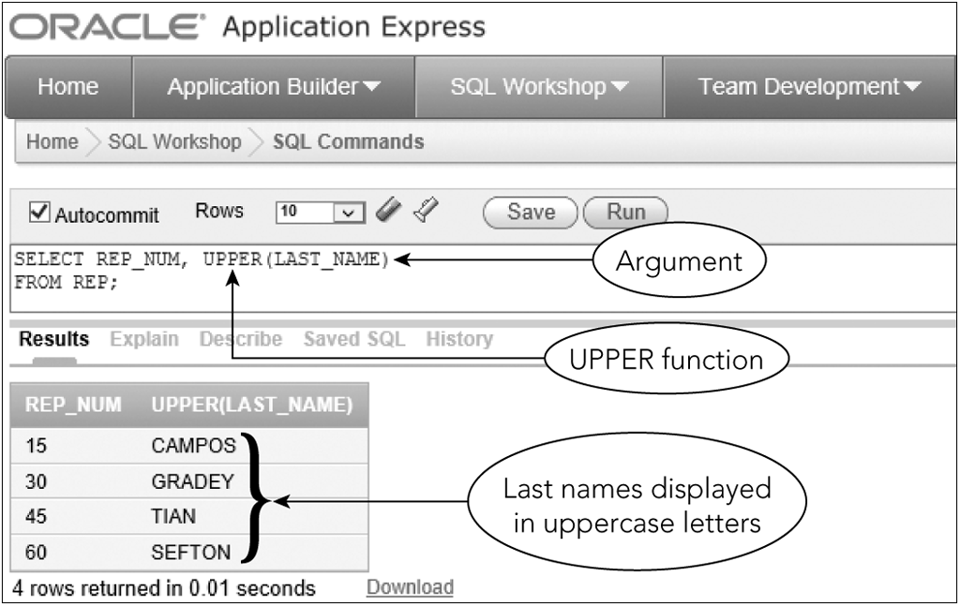
Character Functions
Figure 8-1: Using the UPPER function to display character data in uppercase letters

Slide 6
Number Functions
ROUND
Rounds values to a specified number of decimal places
Requires two arguments
FLOOR
Truncates everything to the right of the decimal place
Not supported by Access

Slide 7
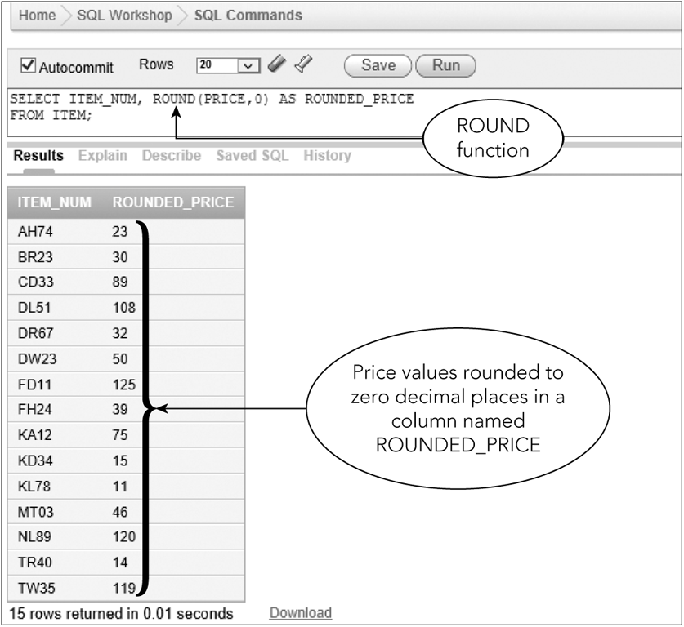
Number Functions
Figure 8-2: Using the ROUND function to round numeric values

Slide 8
Working with Dates
ADD_MONTHS
Adds a specific number of months to a date
Has two arguments
MS Access and SQL Server use DATEADD function to add months
Add a specific number of days
Use a simple calculation
Can also subtract

Slide 9
Working with Dates
SYSDATE
Obtains today’s date (Oracle)
DATE()
Obtains today’s date (MS Access)
GETDATE()
Obtains today’s date (MS SQL Server)

Slide 10
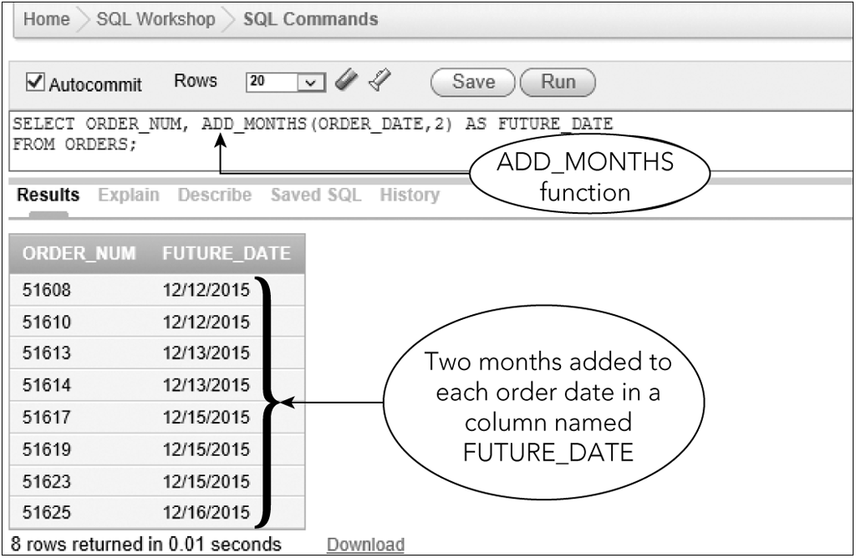
Working with Dates
Figure 8-3: Using the ADD_MONTHS function to add months to a date

Slide 11
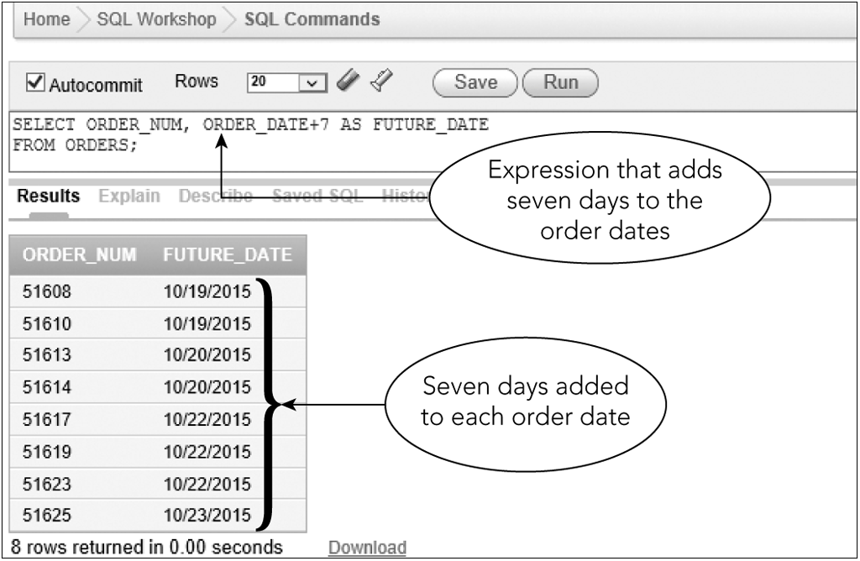
Working with Dates
Figure 8-4: Adding days to dates

Slide 12
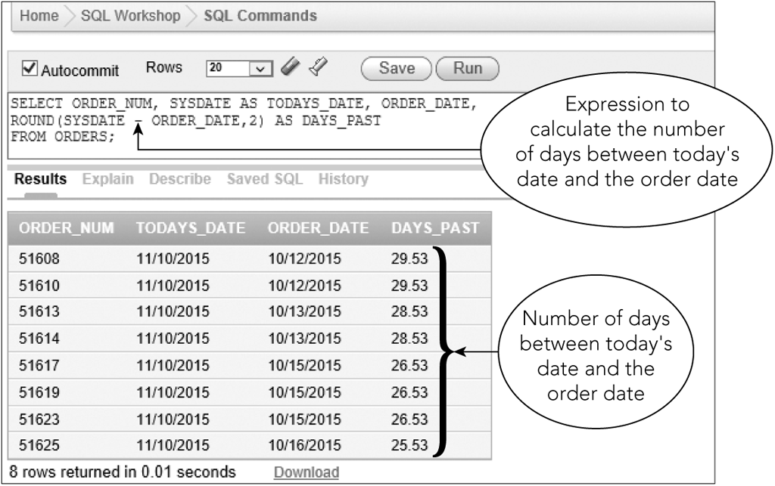
Working with Dates
Figure 8-5: Calculating the number of days between two dates

Slide 13
Concatenating Columns
Concatenate
Combine two or more columns into a single expression
Type two vertical lines (||) (Oracle)
& symbol (MS Access)
+ symbol (MS SQL Server)
RTRIM function
Removes extra spaces to the right of a value

Slide 14
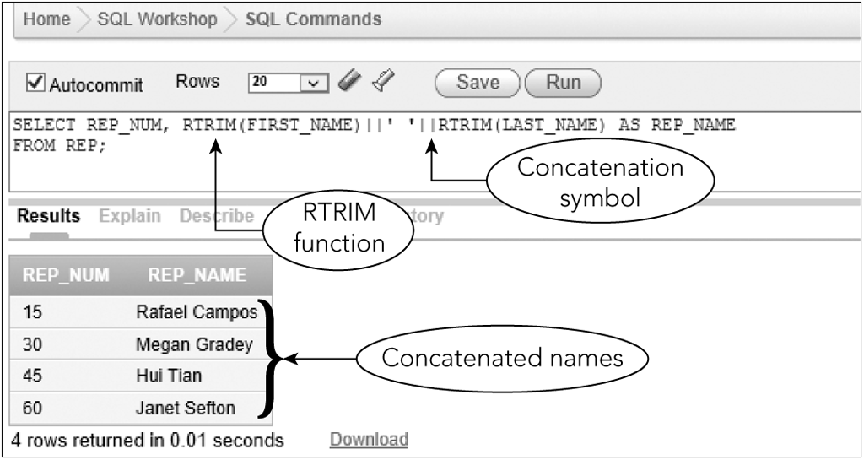
Concatenating Columns
Figure 8-6: Concatenating two columns and using the RTRIM function

Slide 15
Exercise
Use the CAT database to complete the following exercises.
List the guide number, first name and last name for all guides. The first name should appear in lower case and the last name in upper case.
SELECT GUIDE_NUM, LOWER(FIRST_NAME), UPPER(LAST_NAME) FROM GUIDE
List the trip ID and trip name for all trips that start in Bar Harbor. Your query should ignore case.
SELECT TRIP_ID, TRIP_NAME LOWER(START_LOCATION) FROM TRIP WHERE START_LOCATION = ‘bar harbor’;
List the reservation ID, trip date and price for all trips. The price should be rounded to the nearest dollar.
SELECT RESERVATION_ID, TRIP_DATE, ROUND(TRIP_PRICE, 0) FROM RESERVATION;

Slide 16
Stored Procedures
Useful in client/server systems
Advantages
Procedure is stored on server;
DBMS compiles stored procedure; creates compiled, optimized code to run
Convenience (reduces typing) for client applications
Increases control over data by limiting the client applications.
MS Access does not support stored procedures

Slide 17
Retrieving a Single Row and Column
Use CREATE PROCEDURE command
%TYPE attribute ensures that variable has same data type as a particular column
Procedural code located between BEGIN and END commands
Each variable declaration and command as well as the word END are followed by semicolons
The slash (/) at the end of the program appears on its own line

Slide 18
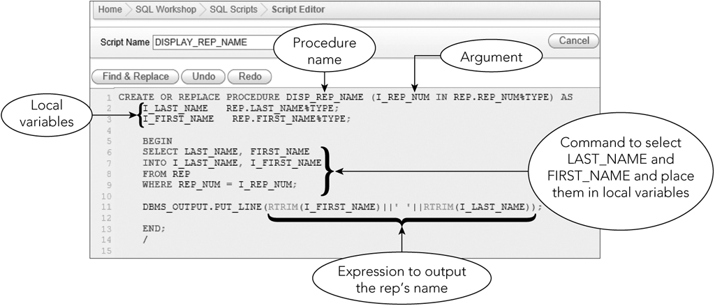
Retrieving a Single Row and Column
Figure 8-7: Procedure to find a rep’s name given the rep’s number

Slide 19
Retrieving a Single Row and Column
When executed, user will be prompted for a value for I_REP_NUM
That value will be used to retrieve the last name and first name of the sales rep whose number equals this value
The results will be placed in the variables I_LAST_NAME, I_FIRST_NAME
DBMS_OUTPUT.PUT_LINE displays concatenated and trimmed rep’s name

Slide 20
Retrieving a Single Row and Column
DBMS_OUTPUT is a package that contains multiple procedures
To call procedure:
Type BEGIN, the name of the procedure, argument in parentheses, END, semicolon, slash

Slide 21
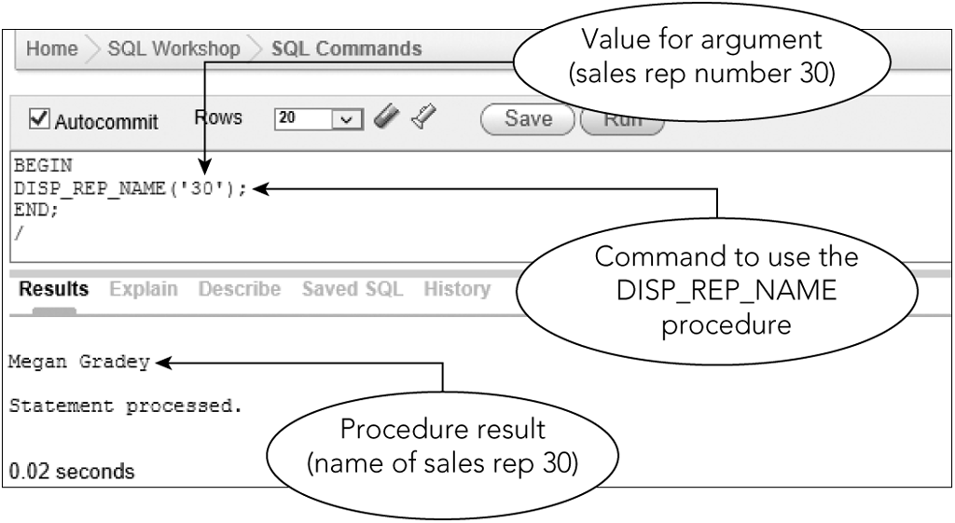
Retrieving a Single Row and Column
Figure 8-8: Using the DISP_REP_NAME procedure within an SQL command

Slide 22
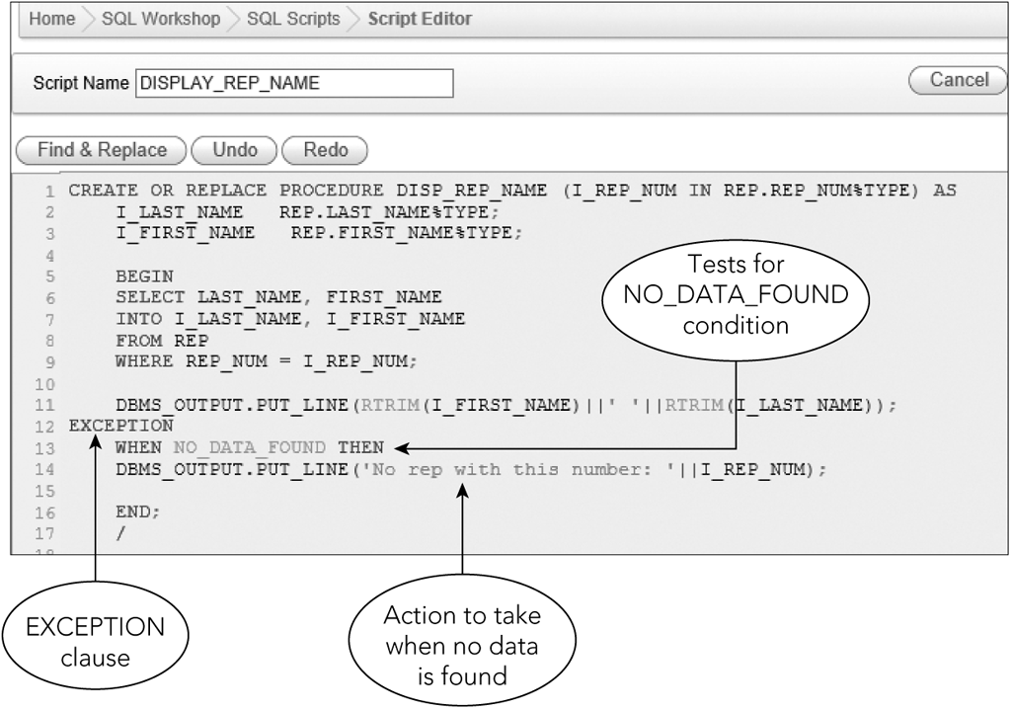
Error Handling
Use EXCEPTION clause
Print an error message
Figure 8-10: PL/SQL procedure with error handling

Slide 23
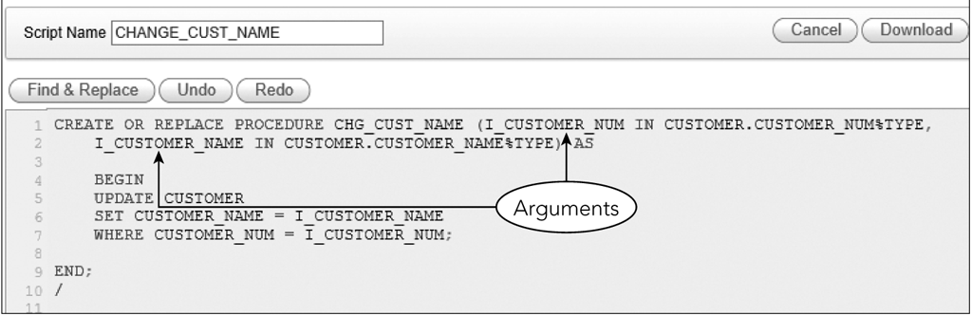
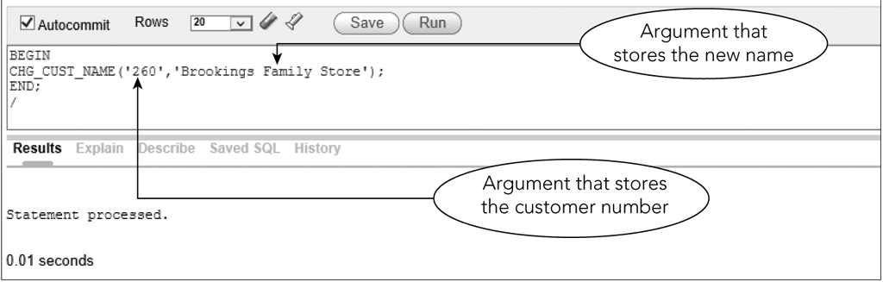
Changing Data with a Procedure
Figure 8-12: Using a procedure to update a row
Figure 8-13: Using a procedure to update the name of customer 260

Slide 24
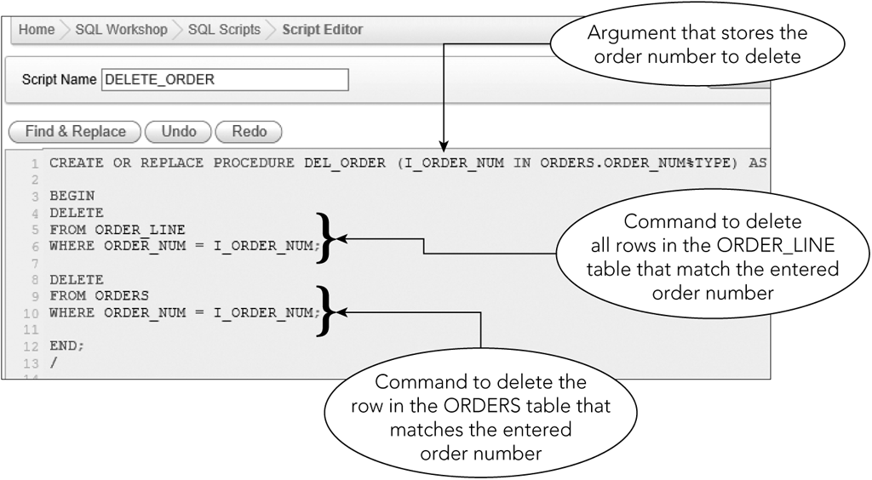
Deleting Data with a Procedure
Figure 8-14: Procedure to delete a row and related rows from multiple tables

Slide 25
Selecting Multiple Rows with a Procedure
PL/SQL can process only one record at a time

Slide 26
Using a Cursor
A cursor is a pointer to a row in the collection of rows retrieved by a SQL command
A cursor advances one row at a time to provide sequential one-record-at-a-time access to retrieved rows

Slide 27
Using a Cursor
The first step is to declare the cursor and describe the associated query in the declaration section
CURSOR CUSTGROUP IS SELECT CUSTOMER_NUM, CUSTOMER_NAME FROM CUSTOMER WHERE REP_NUM = I_REP_NUM;
Three commands are needed
OPEN, FETCH, CLOSE

Slide 28
Opening a Cursor
OPEN command
Opens cursor
Causes query to be executed
Makes results available to the program
Prior to opening, there are no rows available to be fetched
OPEN CUSTGROUP

Slide 29
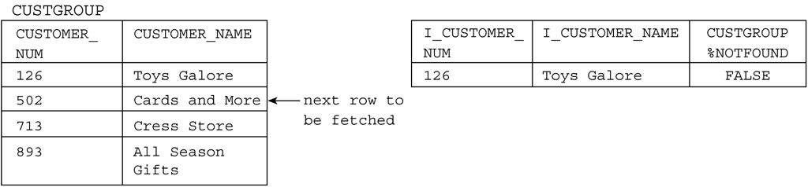
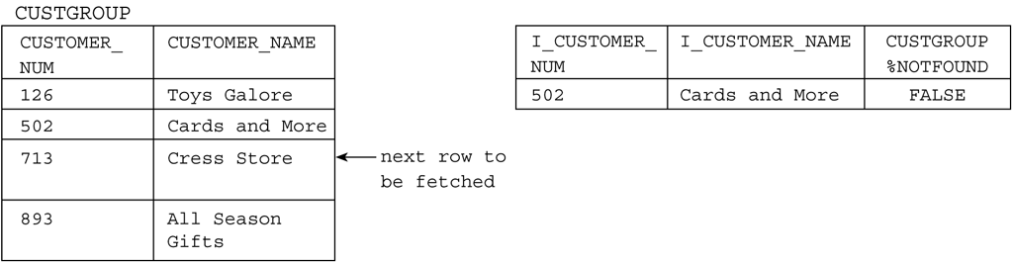
Opening a Cursor
Figure 8-16: Before OPEN
Figure 8-17: After OPEN, but before first FETCH

Slide 30
Fetching Rows from a Cursor
FETCH command
Advances cursor to next row in set of retrieved rows
Places contents of row in indicated variables
FETCH CUSTGROUP INTO I_CUSTOMER_NUM, I_CUSTOMER_NAME;
Execution of fetch command produces only a single row

Slide 31
Fetching Rows from a Cursor
Figure 8-18: After first FETCH
Figure 8-19: After second FETCH

Slide 32
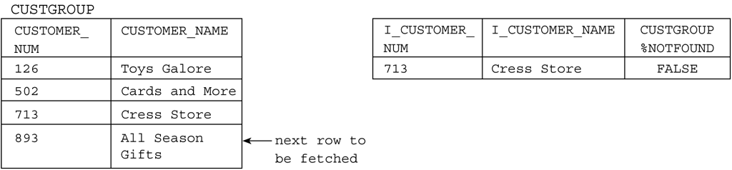
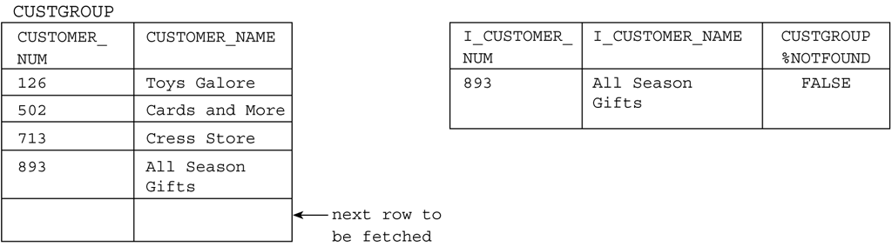
Fetching Rows from a Cursor (continued)
Figure 8-20: After third FETCH
Figure 8-21: After fourth FETCH

Slide 33
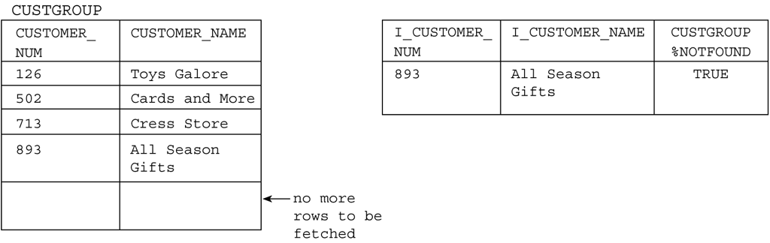
Fetching Rows from a Cursor (continued)
Figure 8-22: After attempting a fifth FETCH (CUSTGROUP%NOTFOUND is TRUE

Slide 34
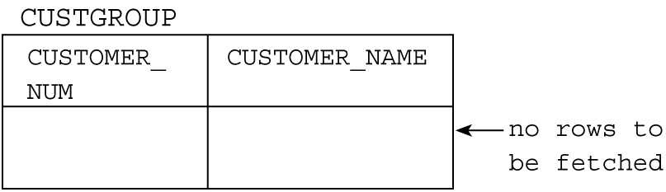
Closing a Cursor
CLOSE command
Closes a cursor and deactivates it
Data retrieved by execution of the query is no longer available
Figure 8-23: After CLOSE

Slide 35
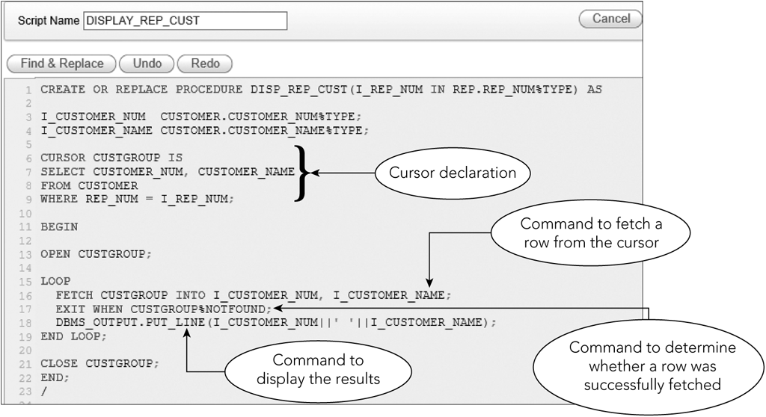
Writing a Complete Procedure Using a Cursor
Figure 8-24: Procedure with a cursor

Slide 36
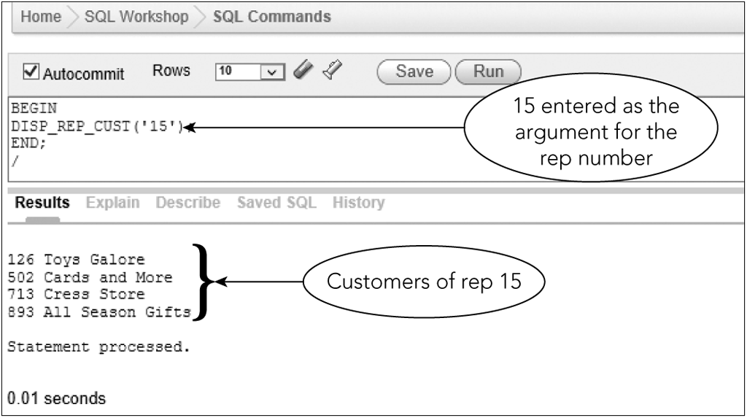
Writing a Complete Procedure Using a Cursor
Figure 8-25: Results of using the procedure

Slide 37
Using More Complex Cursors
Any SQL query is legitimate in a cursor definition
More complicated retrieval requirements result in greater benefits

Slide 38
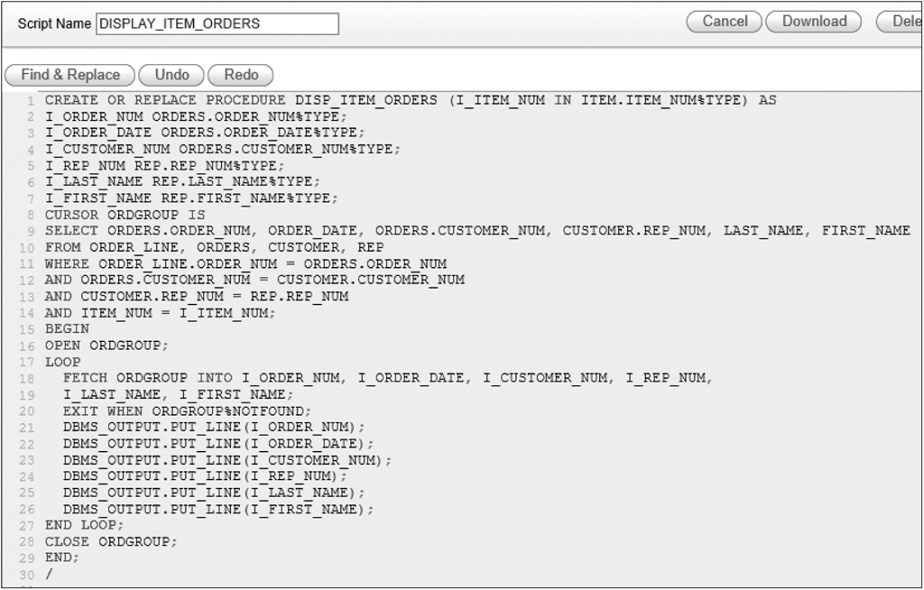
Using More Complex Cursors
Figure 8-26: Procedure with a cursor that involves joining multiple tables

Slide 39
Advantages of Cursors
Simplifies coding in the program
Programs with embedded SQL utilize the optimizer
Programmer doesn’t worry about the best way to retrieve data
Program doesn’t have to change even if the underlying structure does
Cursor definition only changes; not procedural code

Slide 40
Using a Trigger
Procedure that is executed automatically in response to an associated database operation
CREATE TRIGGER
SQL commands between BEGIN and END
NEW qualifier refers to row that is added
OLD qualifier refers to row that was deleted or updated

Slide 41
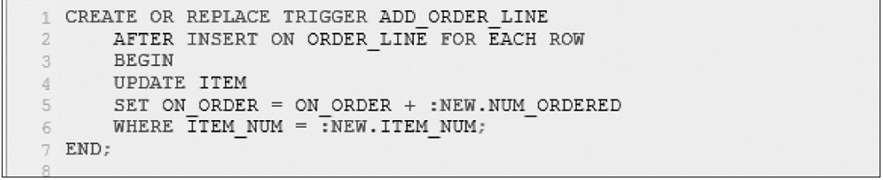
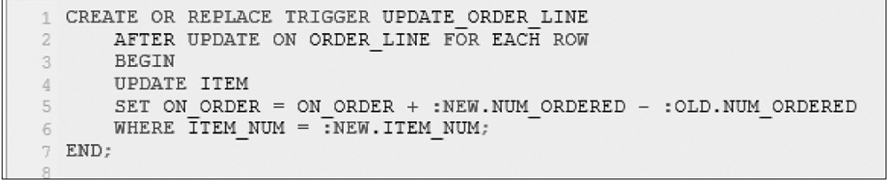
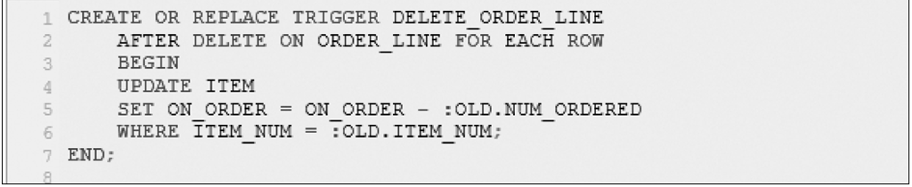
Using a Trigger
Figure 8-34: ADD_ORDER_LINE trigger
Figure 8-35: UPDATE_ORDER_LINE trigger

Slide 42
Summary
Functions
Character (UPPER, LOWER)
Numeric (ROUND, FLOOR)
Date (ADD_MONTHS, SYSDATE)
Concatenation
RTRIM
(||) lines
Stored procedure
Query saved in a file that users can execute later
CREATE PROCEDURE

Slide 43
Summary
Variables
Declare
%TYPE attribute
INTO clause in SELECT places results in variables
INSERT, UPDATE, and DELETE in PL/SQL
Cursors
OPEN, FETCH, CLOSE
Trigger
Action that occurs automatically
Stored and compiled on server
Executed in response to a database operation

Slide 44
Exercise
Use the CAT database to complete the following exercises. Execute each procedure to validate the results.
Write a PL/SQL stored procedure to add a row to the GUIDE table.
Write a PL/SQL stored procedure to delete a row from the GUIDE table.
Write a PL/SQL stored procedure that changes the maximum group size of a trip for a given trip ID.

